Slide 1
Unit 203: Electrical installations technology
Technical information

Slide 2
Sources of technical information:
specifications (to select correct materials)
drawings (provide technical information on wiring systems)
BS 7671
On-Site Guide
Unite Union Book
manufacturers’ data
Guidance Notes (install in accordance with Regulations)
client’s needs.

Slide 3
Specifications, drawings and diagrams
In order to enable the various contractors to tender for the work, detailed specifications, drawings and diagrams have to be produced.
It is essential that, when pricing against other companies, everyone uses the same base for their final price.
Installation specifications give complete details of what is to be included in the installation, including plans.
They will give details of the equipment to be installed, where it is to be installed, sizes, etc.

Slide 4
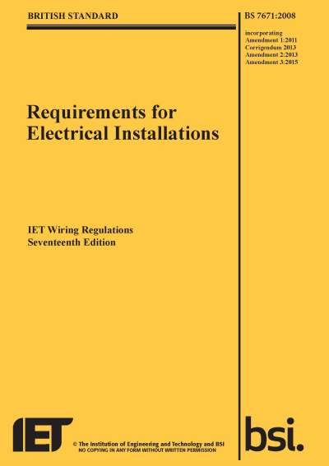
BS 7671 (Requirements for Electrical Installations)
These are the national standard in the United Kingdom for low voltage electrical installations.
The IET (formerly IEE) has published wiring Regulations in the United Kingdom since 1882.
Today, they are largely based on the European Committee for Electrotechnical Standardization (CENELEC) harmonization documents.

Slide 5
In 1992, the IEE Wiring Regulations became British Standard BS 7671 and they are now treated similarly to other British Standards.
Although the IET and BSI are non-governmental organisations and the Wiring Regulations are non-statutory, they are referenced in several UK statutory instruments.

Slide 6
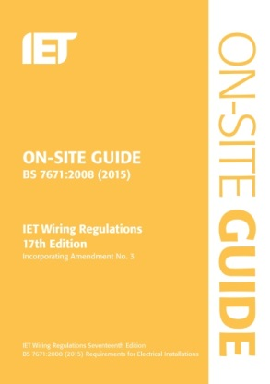
On‑Site Guide
The On‑Site Guide published by the IET is a handbook that contains some information that is not found in BS 7671.
It is meant as a handy notebook reference for electricians working on building sites.

Slide 7

Unite Union Book
This book has been published by the trade union ‘Unite’ for over 20 years.
The Electrician’s Guide to Good Electrical Practice revised to BS 7671, contains a wealth of information for the practising electrician.
This information is based on BS 7671 but contains much more and is, additionally, pocket‑sized and therefore ideal to keep in the toolbox or van for reference purposes.

Slide 8
Manufacturers’ information and data
Manufacturers provide a wide range of information about their products in general and specifically to individual equipment or components.
Catalogues are produced which illustrate the type and range produced by that manufacturer.
The production costs of these catalogues, and so on is covered by the price charged by the manufacturer.
Data sheets are normally provided with individual accessories or components where needed.
Paper based systems tend to get out of date relatively quickly.
Widespread access to the internet means that most companies have started to place all their catalogues and data on their websites.

Slide 9
IET Guidance Notes
The IET issues a number of Guidance Notes based on different topics. They provide additional clarification on how to implement and comply with BS 7671. Current titles are:
Guidance Note 1: Selection and Erection, 7th Edition
Guidance Note 2: Isolation and Switching, 7th Edition
Guidance Note 3: Inspection and Testing, 7th Edition
Guidance Note 4: Protection Against Fire, 7th Edition
Guidance Note 5: Protection Against Electric Shock, 7th Edition
Guidance Note 6: Protection Against Overcurrent, 7th Edition
Guidance Note 7: Special Location, 5th Edition
Guidance Note 8: Earthing and Bonding, 3rd Edition
Although all are important when designing and installing electrical installations, the most popular in the set is Guidance Note 3: Inspection and Testing.

Slide 10
Client’s needs
The client or customer will produce a general statement as to what they require.
They will normally appoint an architect or consultant to produce a more detailed plan for approval.
Once approved by the client (and approving authority), the customer’s agent will draw up detailed plans and specifications.

Slide 11
Unit 203: Electrical installations technology
The End

